Slide 1
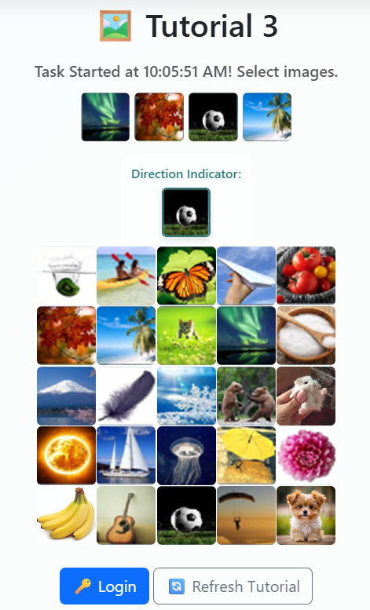


























Registered Password
Registered Direction Indicator
You need to use the Registered Password and Registered Direction Indicator to find the actual password to login

Slide 2
Tutorial 3
We will use :
*PW to represent Actual Password to Click
*RP to represent Registered Password
*DI to represent Registered Direction Indicator
Tutorial 3 using:
8 Directions Rules – North, South, East, West, Northeast, Northwest, Southeast, Southwest
Will have Normal Case
Will have 1 Special Case (Registered Password is same as Registered Direction Indicator)
*RP
*PW
*DI

Slide 3
Tutorial 3: Normal Case Example
*PW
Actual Password to Click
*RP
Registered Password
*DI
Direction Indicator
1.Direction Indicator At North of Registered Password
2.Direction Indicator At South of Registered Password
3.Direction Indicator At East of Registered Password
4.Direction Indicator At West of Registered Password
*PW
*DI
*RP
*RP
*PW
*DI
*RP
*PW
*DI
*DI
*PW
*RP
5.Direction Indicator At Northeast of Registered Password
6.Direction Indicator At Northwest of Registered Password
7.Direction Indicator At Southeast of Registered Password
8.Direction Indicator At Southwest of Registered Password
*RP
*PW
*RP
*PW
*DI
*DI
*DI
*DI
*PW
*PW
*RP
*RP

Slide 4
Tutorial 3: Special Case Example
*PW
Actual Password to Click
*RP
Registered Password
*DI
Direction Indicator
Direction Indicator is Same As Registered Password
*PW
*DI
*RP

Slide 5
Tutorial 3 – Normal Case Example

Slide 6
Tutorial 3: Normal Case
Registered Password
Registered Direction Indicator
When the Direction Indicator (*DI) is at North (up) of Registered Password (*RP). The Actual Password to Click (*PW) is at North (up) of Registered Password (*RP).
*DI
*DI
*RP

Slide 7
Tutorial 3: Normal Case
Registered Password
Registered Direction Indicator
*PW
So, the *PW is
*DI
*DI
*RP

Slide 8
Tutorial 3: Normal Case
Registered Password
Registered Direction Indicator
When the Direction Indicator (*DI) is at South (bottom) of Registered Password (*RP). The Actual Password to Click (*PW) is at South (bottom) of Registered Password (*RP).
*RP
*DI

Slide 9
Tutorial 3: Normal Case
Registered Password
Registered Direction Indicator
So, the *PW is
*RP
*PW
*DI

Slide 10
Tutorial 3: Normal Case
Registered Password
Registered Direction Indicator
When the Direction Indicator (*DI) is at East (right) of Registered Password (*RP). The Actual Password to Click (*PW) is at East (right) of Registered Password (*RP).
*RP
*DI

Slide 11
Tutorial 3: Normal Case
Registered Password
Registered Direction Indicator
So, the *PW is
*RP
*PW
*DI

Slide 12
Tutorial 3: Normal Case
Registered Password
Registered Direction Indicator
When the Direction Indicator (*DI) is at West (left) of Registered Password (*RP). The Actual Password to Click (*PW) is at West (left) of Registered Password (*RP).
*DI
*RP

Slide 13
Tutorial 3: Normal Case
Registered Password
Registered Direction Indicator
So, the *PW is
*DI
*PW
*RP

Slide 14
Tutorial 3: Normal Case
Registered Password
Registered Direction Indicator
When the Direction Indicator (*DI) is at Northeast (up & to right) of Registered Password (*RP). The Actual Password to Click (*PW) is at Northeast (up & to right) of Registered Password (*RP).
*DI
*RP

Slide 15
Tutorial 3: Normal Case
Registered Password
Registered Direction Indicator
So, the *PW is
*DI
*PW
*RP

Slide 16
Tutorial 3: Normal Case
Registered Password
Registered Direction Indicator
When the Direction Indicator (*DI) is at Northwest (up & to left) of Registered Password (*RP). The Actual Password to Click (*PW) is at Northwest (up & to left) of Registered Password (*RP).
*DI
*RP

Slide 17
Tutorial 3: Normal Case
Registered Password
Registered Direction Indicator
So, the *PW is
*DI
*PW
*RP

Slide 18
Tutorial 3: Normal Case
Registered Password
Registered Direction Indicator
*RP
When the Direction Indicator (*DI) is at Southeast (bottom & to right) of Registered Password (*RP). The Actual Password to Click (*PW) is at Southeast (bottom & to right) of Registered Password (*RP).
*DI

Slide 19
Tutorial 3: Normal Case
Registered Password
Registered Direction Indicator
*RP
So, the *PW is
*PW
*DI

Slide 20
Tutorial 3: Normal Case
Registered Password
Registered Direction Indicator
When the Direction Indicator (*DI) is at Southwest (bottom & to left) of Registered Password (*RP). The Actual Password to Click (*PW) is at Southwest (bottom & to left) of Registered Password (*RP).
*RP
*DI

Slide 21
Tutorial 3: Normal Case
Registered Password
Registered Direction Indicator
So, the *PW is
*RP
*PW
*DI

Slide 22
Tutorial 3 – Special Case Example

Slide 23
Tutorial 3: Special Case
Registered Password
Registered Direction Indicator
When the Direction Indicator (*DI) is same as the Registered Password (*RP). The Actual Password to Click (*PW) is the Registered Password (*RP).
*DI
*RP

Slide 24
Tutorial 3: Special Case
Registered Password
Registered Direction Indicator
So, the *PW is
*PW
*DI
*RP

Slide 25
Tutorial 3 – Demo Example

Slide 26
Tutorial 3: Demo Example
Registered Password :
Registered Direction Indicator :

Slide 27
Tutorial 3: Demo Example
Registered Password
Registered Direction Indicator
Registered Password
Registered Password
Registered Password
When the Direction Indicator (*DI) is at East (right) of Registered Password (*RP1). The Actual Password to Click (*PW) is at East (right) of Registered Password (*RP1).
*RP1
*DI

Slide 28
Tutorial 3: Demo Example
Registered Password
Registered Direction Indicator
Registered Password
Registered Password
Registered Password
So, the *PW is
*PW
*RP1
*DI

Slide 29
Tutorial 3: Demo Example
Registered Password
Registered Direction Indicator
Registered Password
Registered Password
Registered Password
When the Direction Indicator (*DI) is at Northwest (up & to left) of Registered Password (*RP2). The Actual Password to Click (*PW) is at Northwest (up & to left) of Registered Password (*RP2).
*DI
*RP

Slide 30
Tutorial 3: Demo Example
Registered Password
Registered Direction Indicator
Registered Password
Registered Password
Registered Password
So, the *PW is
*PW
*DI
*RP

Slide 31
Tutorial 3: Demo Example
Registered Password
Registered Direction Indicator
Registered Password
Registered Password
Registered Password
*RP3
When the Direction Indicator (*DI) is at Southeast (bottom & to right) of Registered Password (*RP3). The Actual Password to Click (*PW) is at Southeast (bottom & to right) of Registered Password (*RP3).
*DI

Slide 32
Tutorial 3: Demo Example
Registered Password
Registered Direction Indicator
Registered Password
Registered Password
Registered Password
*RP3
So, the *PW is
*PW
*DI

Slide 33
Tutorial 3: Demo Example
Registered Password
Registered Direction Indicator
Registered Password
Registered Password
Registered Password
When the Direction Indicator (*DI) is at West (left) of Registered Password (*RP4). The Actual Password to Click (*PW) is at West (left) of Registered Password (*RP4).
*DI
*RP4

Slide 34
Tutorial 3: Demo Example
Registered Password
Registered Direction Indicator
Registered Password
Registered Password
Registered Password
So, the *PW is
*DI
*PW
*RP4

